Slide 1
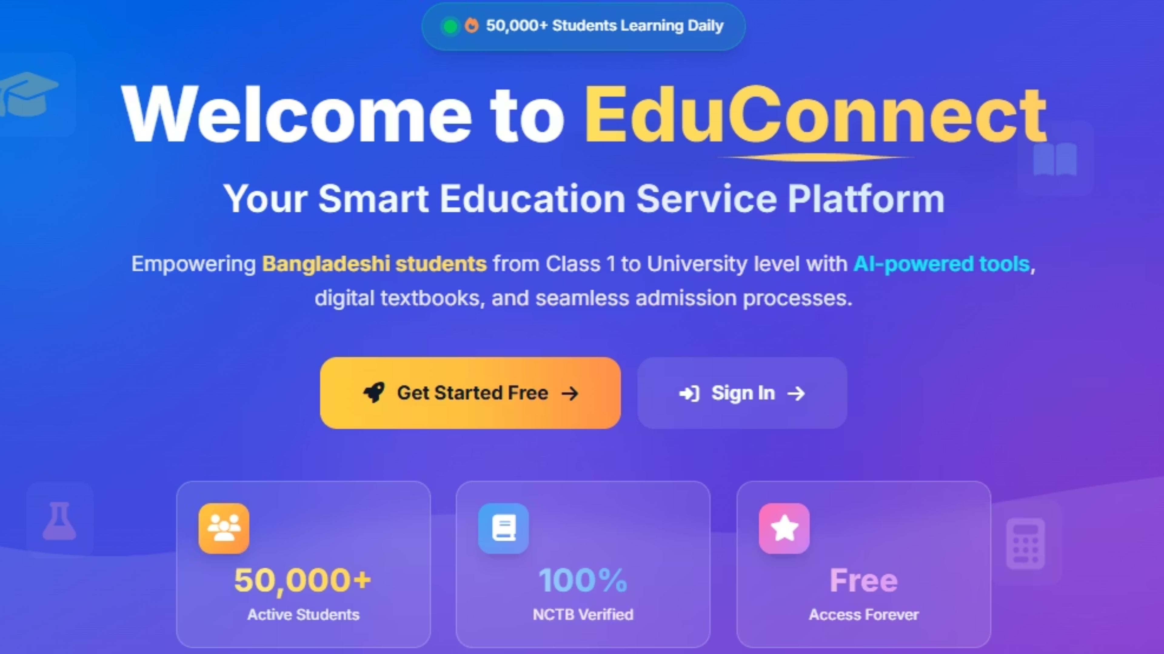
EduConnect: A Smart Education Service Platform
Empowering Education Through Technology
Project Team Member:
Mobarak Hossain Zobaer
ID: 0432220005101029
Sadia Akter Tuly
ID: 0432220005101030
Supervisor:
AL Imtiaz, Department of Head
of Computer Science and Engineering,
University of Information Technology and Sciences (UITS)

Slide 2
Key Objectives for EduConnect
Online Admissions
Result Management
Digital Library Access
Automatic and streamline the university application process online.
Provide and management of academic results SSC and HSC.
Access and download to nationwide NCTB textbooks via a robust digital library.
AI Learning Assistant
News Hub
Secure Platform
Integrate an intelligent AI assistant to provide personalized learning support for students.
Establish a platform for timely educational announcements.
Ensure Every Student Dashboard and advanced role-based authentication sign up , sign In and administrator dashboard.

Slide 3
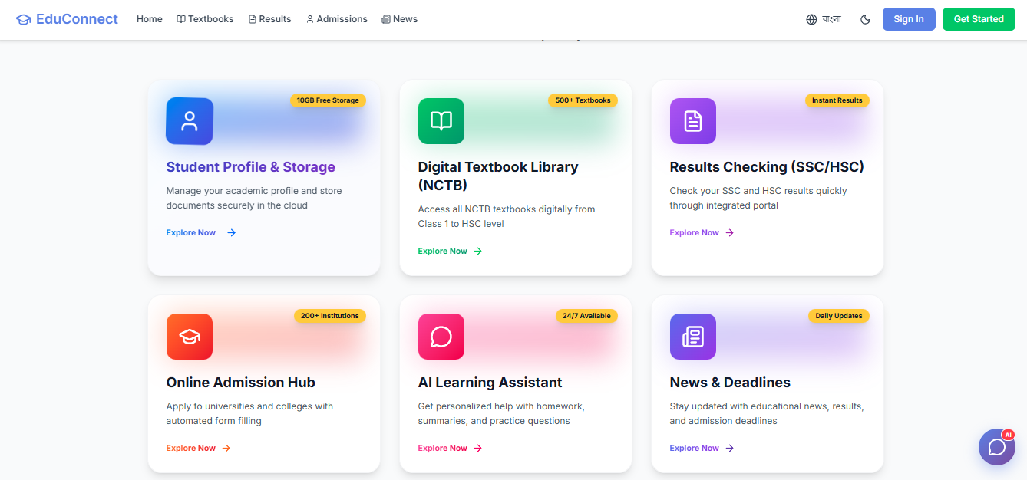

Slide 4


Transforming Educational Challenges into Solutions
Inefficient Educational Ecosystems
EduConnect's Innovative Solutions
Inefficient, manual admissions processes.
Seamless online application and tracking.
Dividing results and checking each section separately.
Centralized system for instant academic updates.
Access to 200+ NCTB digital textbooks.
Restricted access to essential learning resources.
Comprehensive administrative dashboards for data-driven decisions.
There is no single platform that provides all services together.

Slide 5


Feasibility & Market Opportunity
Market Research: Bangladesh
Technical Feasibility: MERN Stack
Bangladesh is experiencing rapid growth in digital education.
Reliability: Uses the trusted MERN stack to make the system reliable.
Over 10 million students require accessible online educational services.
Scalability: Grows easily because it uses a cloud-based database (MongoDB Atlas).
Over 200 universities want an easier, automated admission system.
Cost-Efficiency: Optimized processes make the system cheaper to develop and run.
Our solution helps the Digital Bangladesh vision for education site.
Content: Integrates over 200 digitized NCTB textbooks, greatly expanding content accessibility.

Slide 6

Research & Development Methodology
01
02
Research Methodology
SDLC Model: Agile
Our research started with surveys, interviews, and requirement analysis. We supported this with studies of existing platforms and academic sources.
Our development followed the Agile (Spiral) model, using iterations, regular feedback, flexible requirements, and strong risk control.
03
Development Phases
Phase 1: Foundation (Authentication, Database) – Established core architectural components.
Phase 2: Core Features (Admissions, Student Profile) – Implemented essential user functionalities.
Phase 3: Advanced (AI Assistant) – Creating powerful AI and data analytics tools..

Slide 7

System Architecture: Data Flow Diagram
Authentication
Admission Processing
Results Publication
Content Management
It provides critical insight into system boundaries, core functionalities, and the dynamic movement of information.

Slide 8
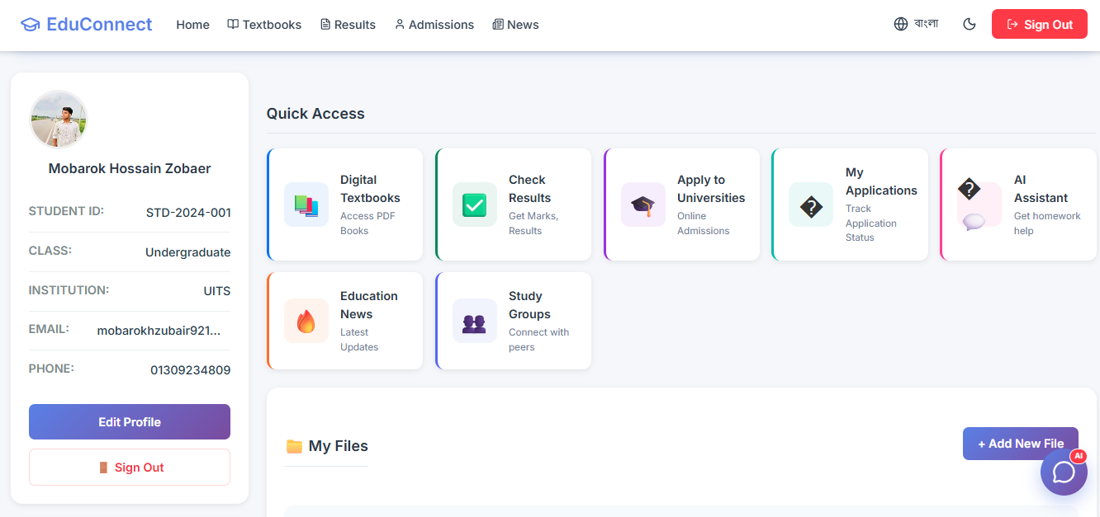
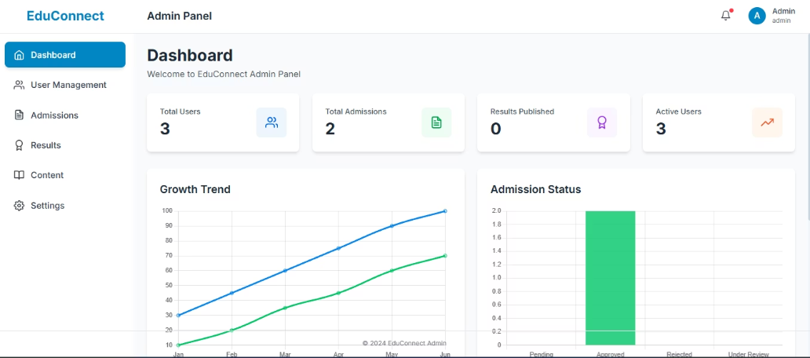
EduConnect: Comprehensive Features Overview
Student Website
Admin Portal
Dynamic Dashboard: Provides instant information to help make smart decisions.
Online Admissions: Users can apply and track their application status instantly.
User Management: Provides Create, Read, Update, Delete functionalities.
Efficient Result Retrieval: Students can quickly check their results using their roll number.
Optimized Admission Workflow: Streamlines the approval and rejection processes for all applications.
NCTB Digital Library: Students can access all digital textbooks for grades 1 to 12.
Content Management: Makes it easy to create and share news and updates.
AI Assistant: Provides a smart chatbot to help students
learn better.

Slide 9



Socio-Economic Impact & Future Vision
Enhanced Operational Efficiency
Optimized Cost Structures
Resource Distribution
Delivering significant cost savings for educational institutions through digital transition.
Provides all students with fair access to essential resources.
Assume that we achieving a 70% reduction in processing time for educational institutions, administrative tasks.
Strategic Future Initiatives
Building a mobile app with React Native so more people can use it.
Supports hassle-free financial transactions through bKash and Nagad.
Allows users to choose Bangla or English for easier access

Slide 10

Our Vision Realized
Our three-tier platform transforms education services in Bangladesh, creating notable social and economic impact.
Thank You!

